Slide 1
E-mail lead response time
Who wants to guess how long it took their property to respond?

Slide 2
“Shannon Lindsey” using email address: shannonlindsey1964@outlook.com sent leasing inquiry to all properties on 04/16/18 from either: Apartments.com Apartmentfinder.com rent.com

Slide 3
All leads said the same thing: “I am looking to move in June and need a 2 bedroom. What is the price?”

Slide 4
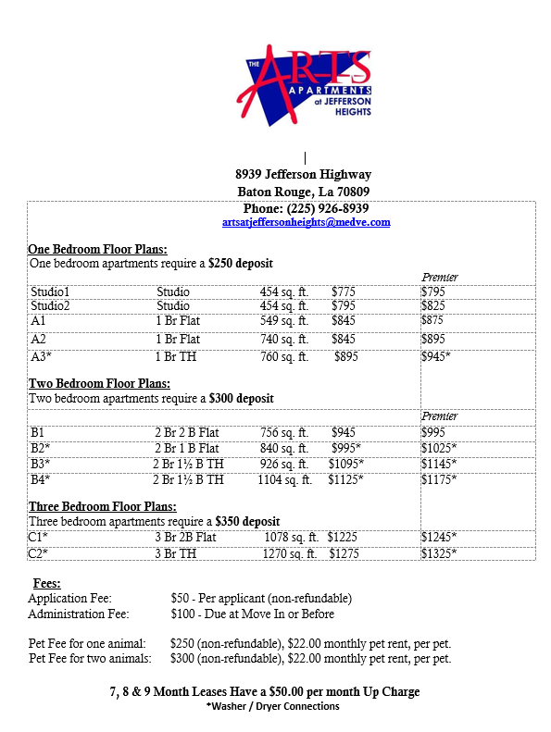
Some of the responses we received:

Slide 5
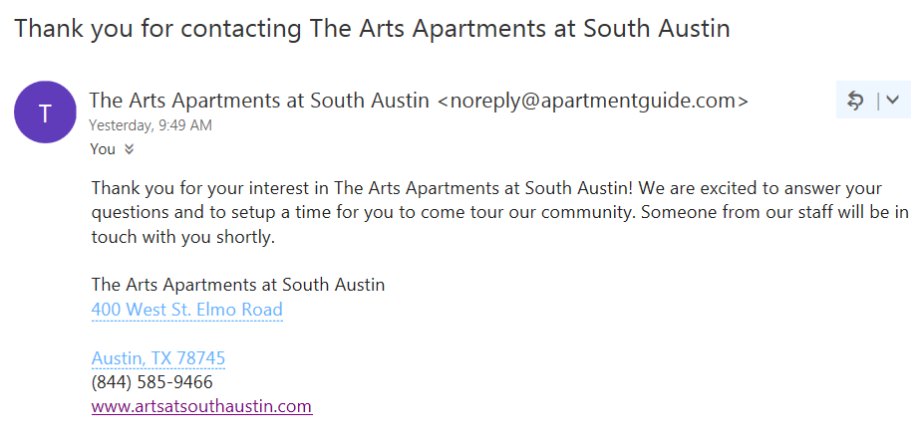
Still waiting…

Slide 6
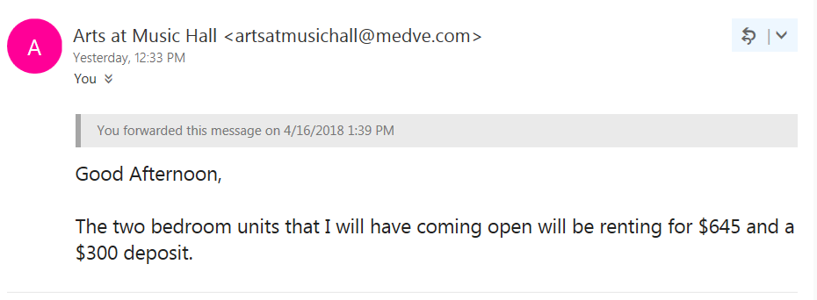

Slide 7
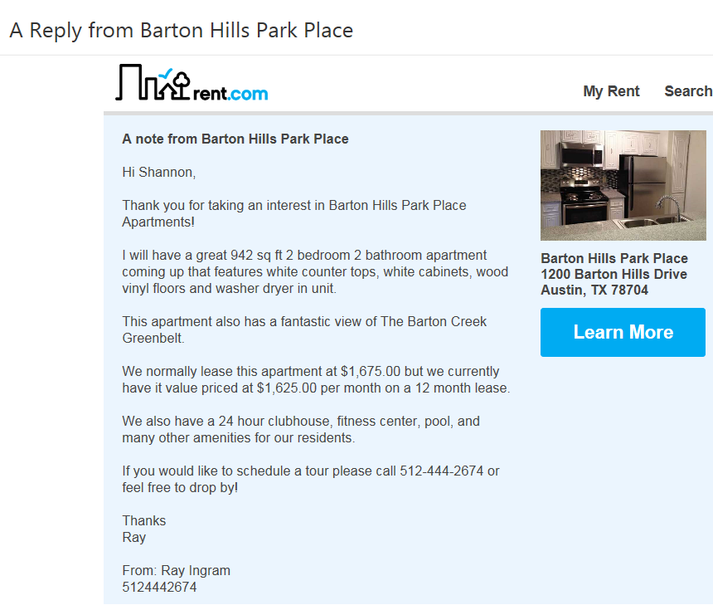
We also received many great responses

Slide 8
MOP: 59 minutes
BBP: NO RESPONSE
AJH: 5 minutes
ABX: 22 minutes
BHPP: 28 minutes
PAL/GAP: NO RESPONSE
TAA: 6 minutes
APP: 2 hours 26 minutes
AOD: 23 minutes
ASA: auto response with no follow-up
SCA: 15 minutes
ABC: NO RESPONSE
AWN: 1 hour 39 minutes
TERRACES 1/3: 1hour 46 minutes
ATC: NO RESPONSE (2nd year in a row)
TERRACES 2: 1 hour 25 min & another 46 min later
AMH: 3 hours 23 minutes
RTA: NO RESPONSE

Slide 9
Out of everyone who did reply…
ONLY TAA (Hope) and TTM (Cilia) entered Shannon as traffic into Onesite.

